Slide 1
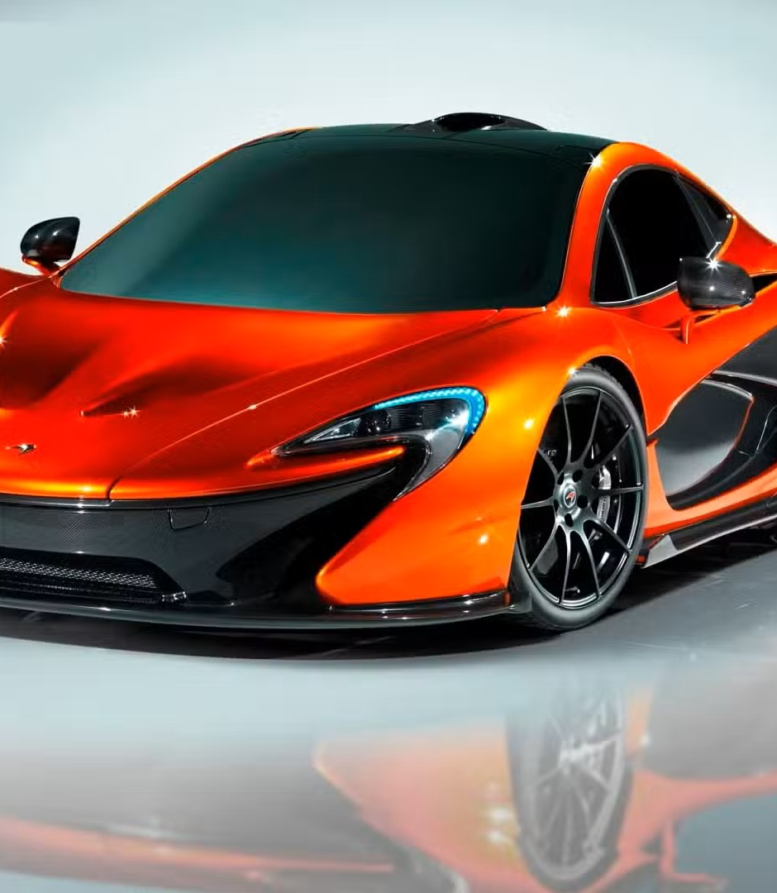
Car simulation Project
Veselin Atanasov
Abdullah Adil Öncü

Slide 2
Agenda
System Overview
System Design
Demo
Questions

Slide 3
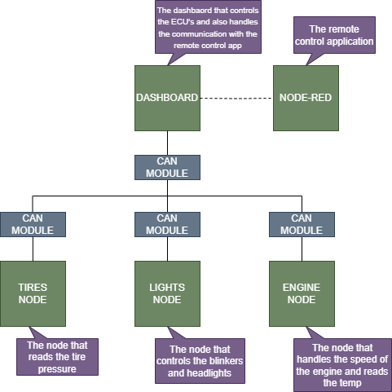
System overview

Slide 4
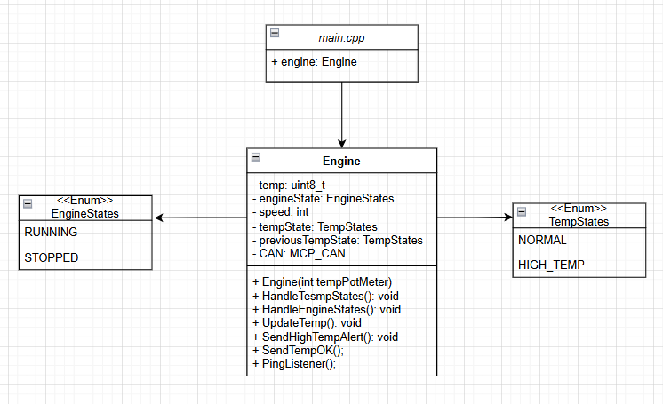
System Design-Engine UML

Slide 5
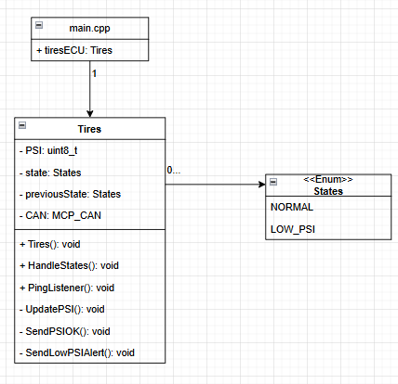
System Design – Tires UML

Slide 6
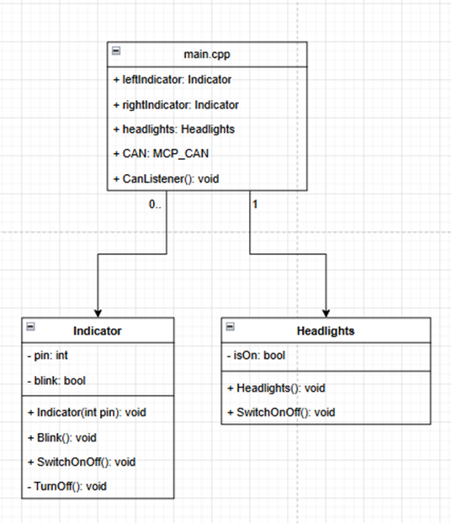
System Design – Light UML
6

Slide 7
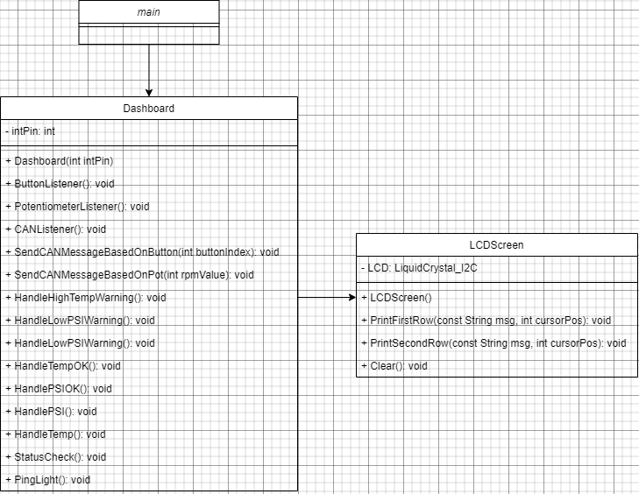
System Design – Dashboard UML
7

Slide 8
Demo

Slide 9
Questions
9

